Slide 1
Enhancing QA Testing Through Generative AI and Language models
Anjali Kulkarni
25 Nov 2023

Slide 2
Agenda
Introduction – Generative AI
QA challenges - AI Solutions
Vertex AI - Terminologies
Using Vertex AI and PaLM APIs
PaLM API parameters
Prompting techniques

Slide 3
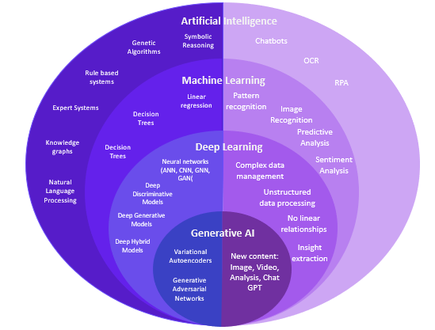
Introduction
Generative AI

Slide 4
QA challenges AI Solutions
Requirement Analysis - NLP
  Summarizations
Regression Testing - NLP
  Impact analysis due to changes
UI or API automation – GenAI
  Automated testcase generation
Testdata generation - GenAI
  Diverse
  Large Volume
  Secure

Slide 5
Vertex AI Terminologies
VertexAI – Google machine learning platform
Foundation models – Pretrained models
PaLM – Pathways AI Language Model
Google BARD – Conversational chat interface
PaLM API – Programmatic interface
Prompt –Context, Natural language request
MakerSuite – Browser based IDE

Slide 6
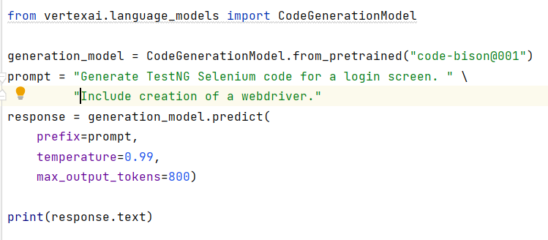
Vertex AI and PaLM APIs
Create a google cloud platform account
Create keys
Save on local machine as environment variables – ‘GOOGLE_APPLICATION_CREDENTIALS’
Install library - google-generativeai
In IDE :

Slide 7
Prompting Techniques
Zero-shot – No sample examples
Few-shot – Setting context for desired responses
Chain-of-Thought (CoT) – Sequence of conditions
Self-Consistency – Sampling of outputs
Generated Knowledge Prompting – Generate knowledge

Slide 8
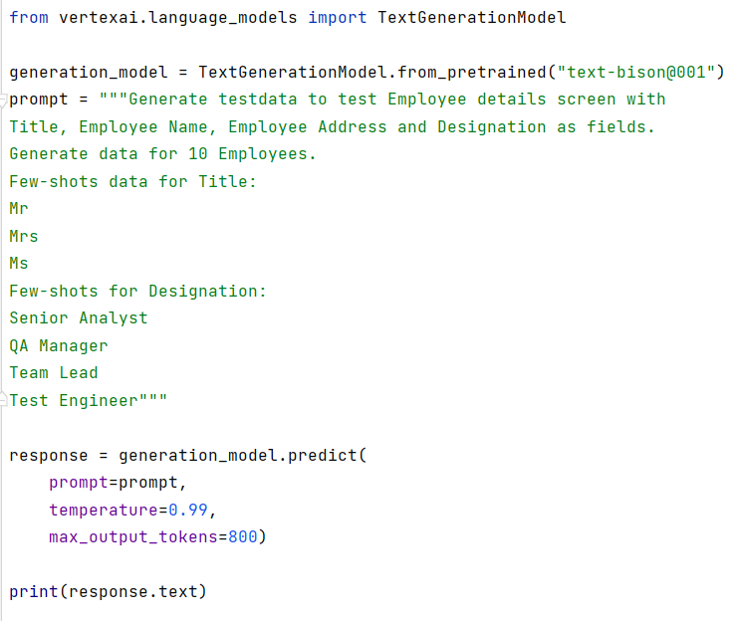
Demo
Testdata Generation

Slide 9
Thank You!!

